Slide 1
Coexistence
Today’s Agenda:
Quiz
Coexistence

Slide 2
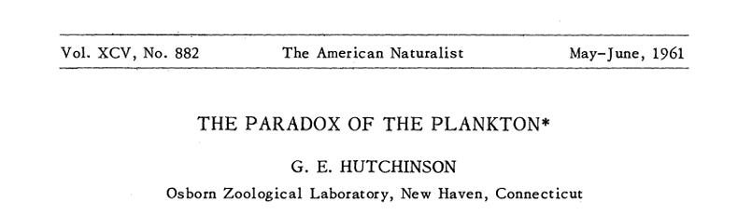
Paradox of the plankton
Species need different niches to coexist
How can so many species of plankton coexist?
All need the same resources
Well-mixed, homogeneous environment

Slide 3
Paradox of the plankton
Species need different niches to coexist
How can so many species of plankton coexist?
All need the same resources
Well-mixed, homogeneous environment
Or, more generally, how can so many species coexist in a given location when they all need more or less the same things (oxygen, water, carbon, etc.)?

Slide 4
How to coexist
We now know the answer (in a broad sense)
What needs to happen for species to coexist?

Slide 5
How to coexist
We now know the answer (in a broad sense)
What needs to happen for species to coexist?
α_{ii} > α_{ji}
α_{jj} > α_{ij}

Slide 6
How to coexist
What causes species to limit themselves more than their competitors?
Different resources
Different predators

Slide 7
How to coexist
What causes species to limit themselves more than their competitors?
Different resources
Different predators
Spatial variation (use different locations)
Temporal variation (use different times)
Some combination of these things

Slide 8
Coexistence via spatial variation
Variation in resources (or predators) within a patch
Different species do best with different levels of that resource/predator

Slide 9
Coexistence via spatial variation
Variation in resources (or predators) within a patch
Different species do best with different levels of that resource/predators
Requires a trade-off!

Slide 10
Coexistence via spatial variation
Variation in resources (or predators) within a patch
Different species do best with different levels of that resource/predators
Requires a trade-off!
Species need to be good at something, bad at others

Slide 11
Coexistence via spatial variation
Variation in resources (or predators) within a patch
Different species do best with different levels of that resource/predators
Requires a trade-off!
Species need to be good at something, bad at others
These difference make species more likely to compete with conspecifics

Slide 12
Coexistence via spatial variation
Variation in resources (or predators) within a patch
Different species do best with different levels of that resource/predators
Requires a trade-off!
Species need to be good at something, bad at others
These difference make species more likely to compete with conspecifics
Increases intraspecific competition relative to interspecific

Slide 13
Coexistence via spatial variation
Variation in resources (or predators) within a patch
Different species do best with different levels of that resource/predators
Requires a trade-off!
Species need to be good at something, bad at others
These difference make species more likely to compete with conspecifics
Increases intraspecific competition relative to interspecific
α_{ii} > α_{ji}

Slide 14
Trade-offs
Can be n-dimensional, but we often focus on 2-dimensional trade-offs

Slide 15
Trade-offs
Can be n-dimensional, but we often focus on 2-dimensional trade-offs
Dominance
Tolerance
Notes:
Tolerance = ability to tolerate stressful condition, dominance = ability to competitively exclude other species

Slide 16
Trade-offs
Can be n-dimensional, but we often focus on 2-dimensional trade-offs
More Stress
Dominance
Tolerance
Notes:
Tolerance = ability to tolerate stressful condition, dominance = ability to competitively exclude other species

Slide 17
Trade-offs
Can be n-dimensional, but we often focus on 2-dimensional trade-offs
Dominance
Competitive Dominance
Tolerance
Predation Tolerance
Notes:
Tolerance = ability to tolerate stressful condition, dominance = ability to competitively exclude other species

Slide 18
Trade-offs
Can be n-dimensional, but we often focus on 2-dimensional trade-offs
More Predation
Dominance
Competitive Dominance
Tolerance
Predation Tolerance
Notes:
Tolerance = ability to tolerate stressful condition, dominance = ability to competitively exclude other species

Slide 19
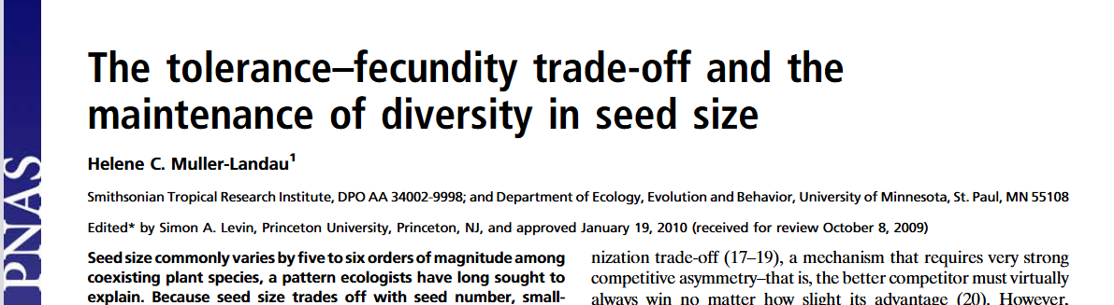
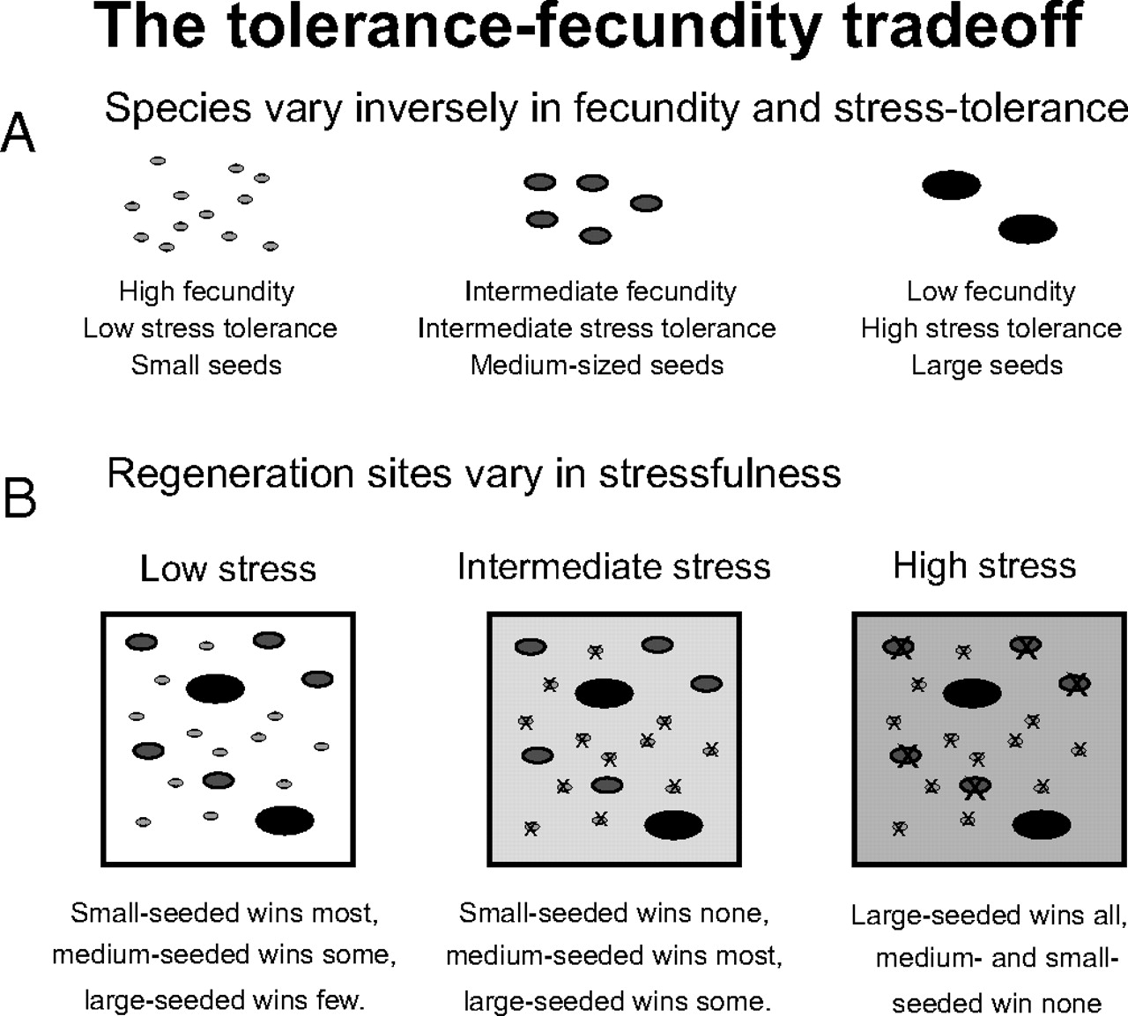
Tolerance-Fecundity

Slide 20
Tolerance-Fecundity
Found theoretical support

Slide 21
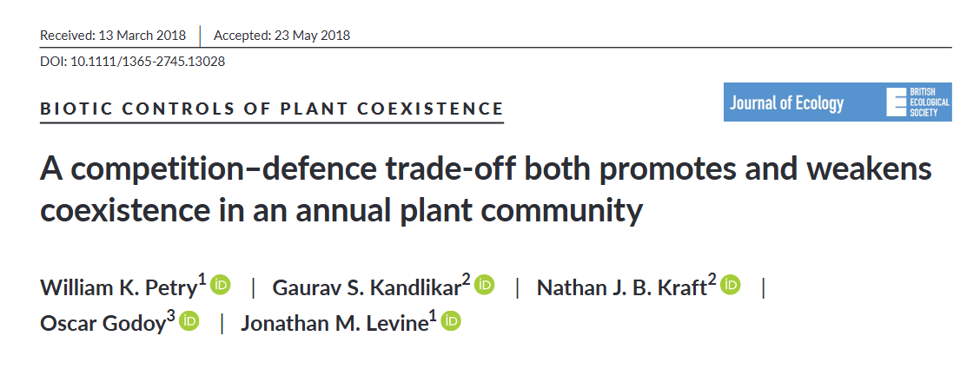
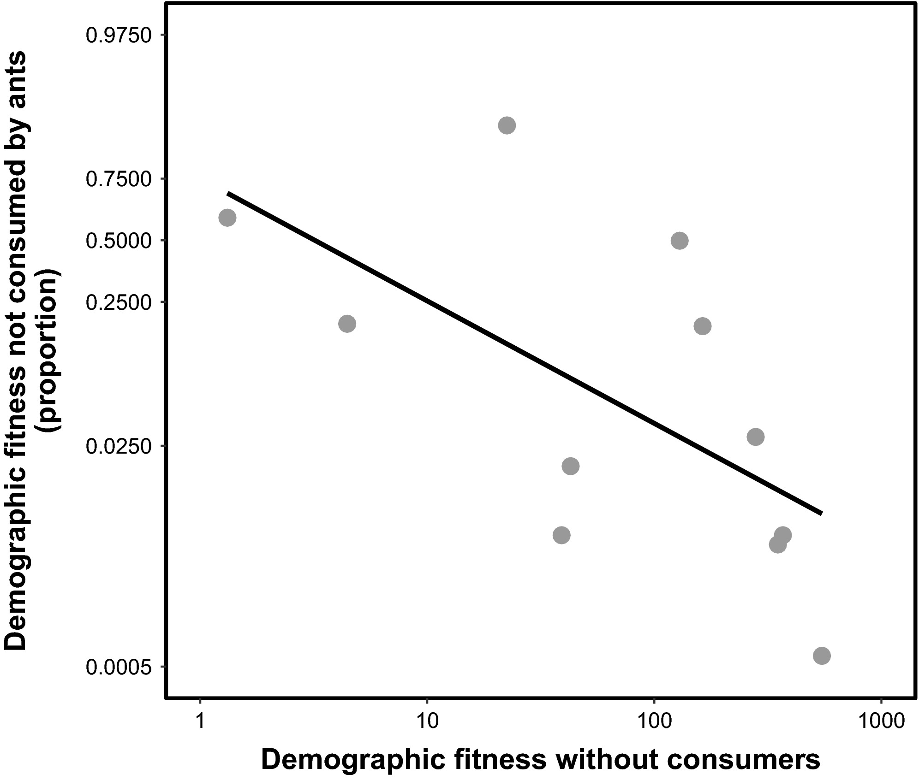
Competition-Defense Trade-off

Slide 22
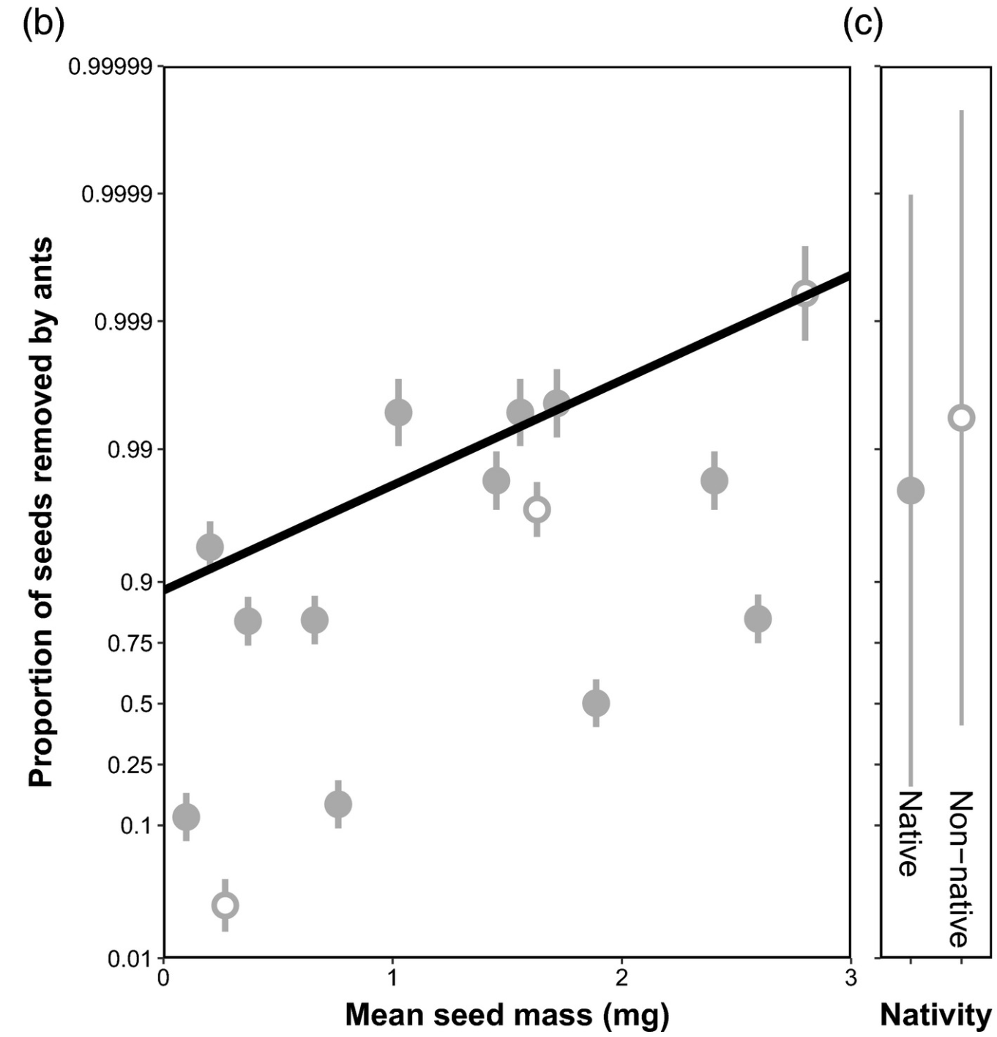
Competition-Defense Trade-off

Slide 23
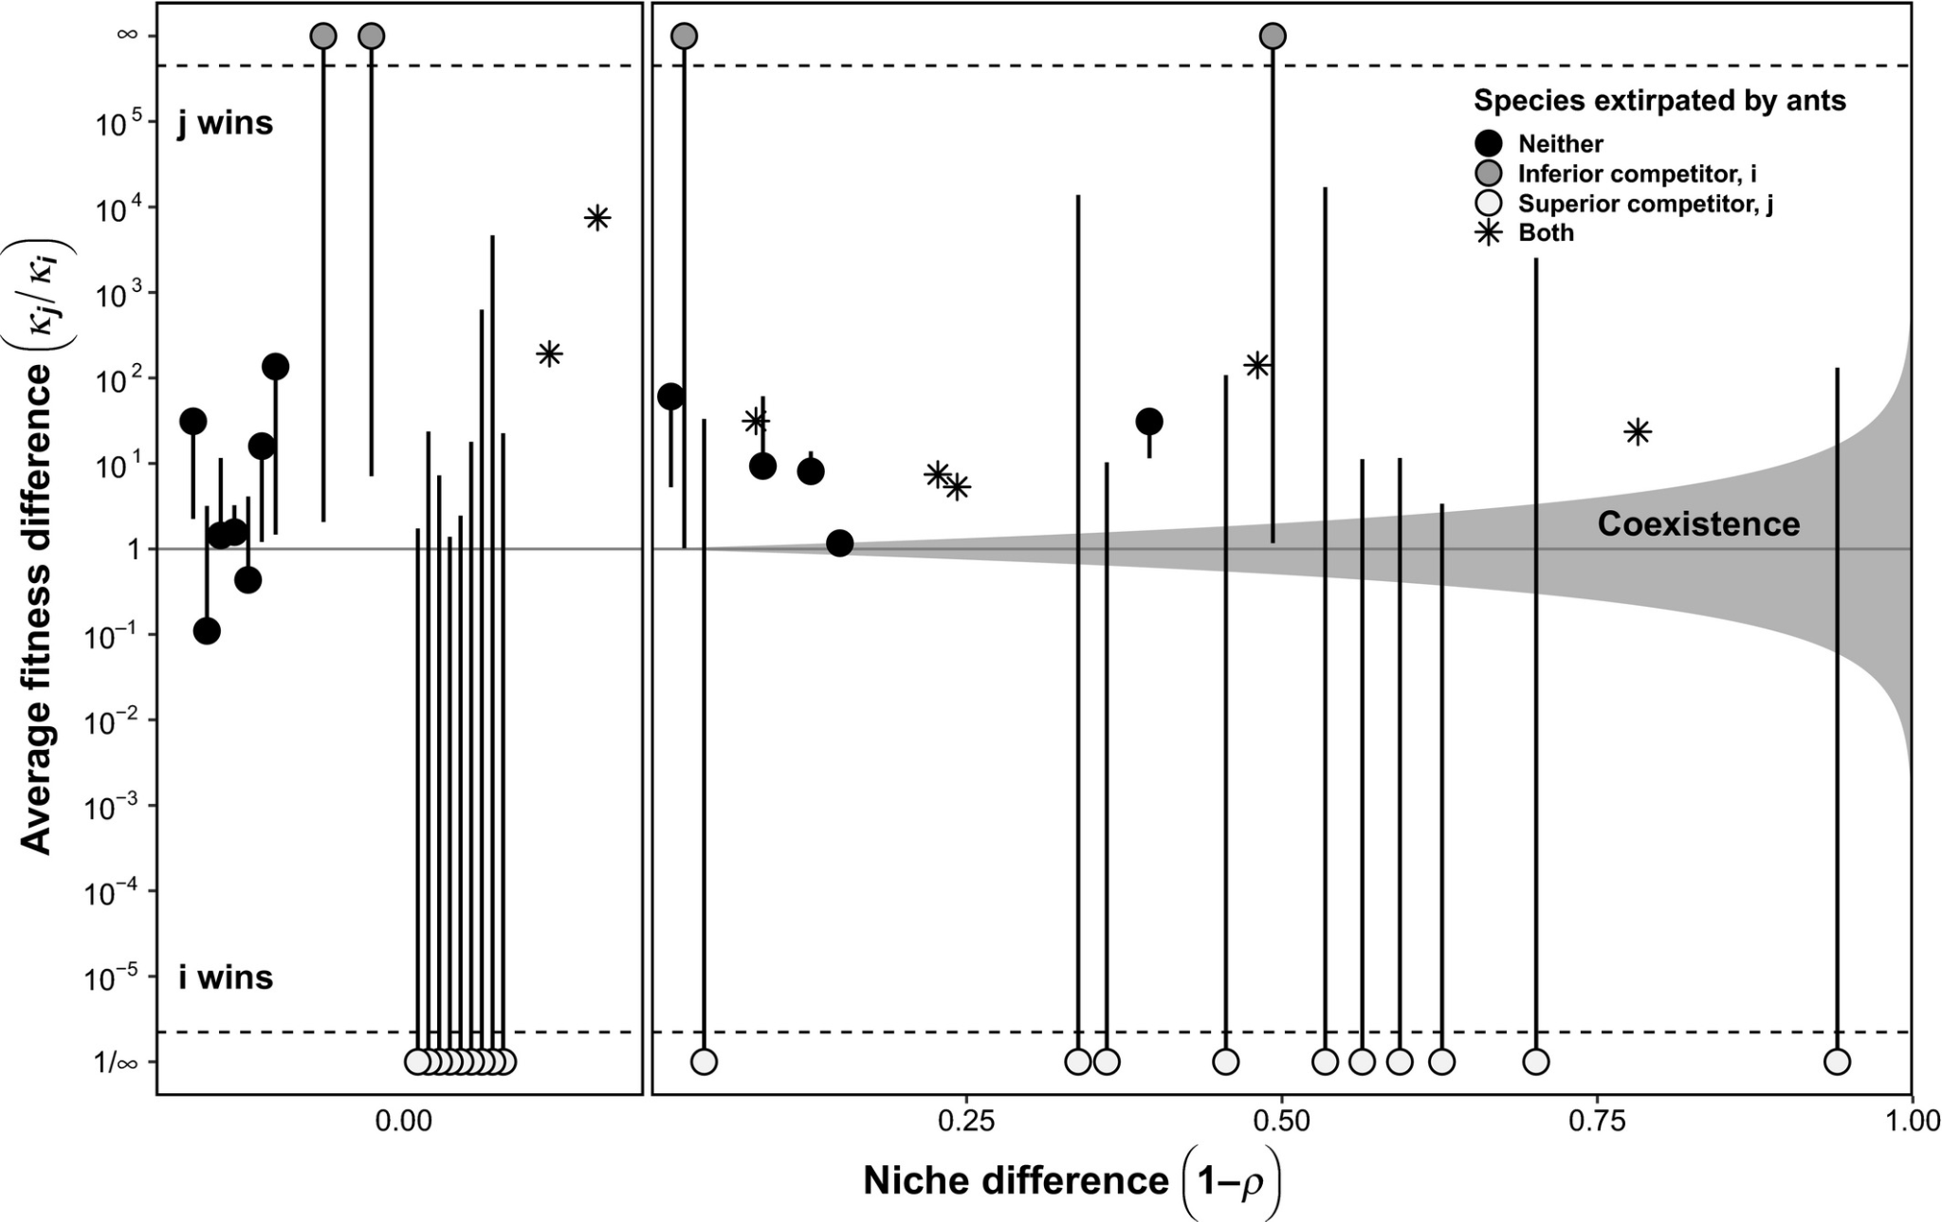
Competition-Defense Trade-off

Slide 24
Competition-Defense Trade-off
Found trade-offs, but…
Trade-off sometimes helped, sometimes made things worse

Slide 25
Coexistence without resource/predation differences
Different preferences
Different habitats
Different strata within a habitat
Notes:
May be driven by camouflage, etc

Slide 26
Coexistence without resource/predation differences
Different preferences
Different habitats
Different strata within a habitat
Same resource, but different locations: increases α_{ii} relative to α_{ji}

Slide 27
Coexistence without resource/predation differences
Different preferences
Different habitats
Different strata within a habitat
Same resource, but different locations: increases α_{ii} relative to α_{ji}
Note that there are a few caveats about this!

Slide 28
Coexistence without resource/predation differences

Slide 29
Coexistence without resource/predation differences
= Competitor
Similar preferences

Slide 30
Coexistence without resource/predation differences
= Competitor
Distinct preferences

Slide 31
Coexistence without resource/predation differences
= Competitor
= Resources
Distinct preferences
Mostly intraspecific

Slide 32
Coexistence without resource/predation differences
= Competitor
= Resources
(can now move)
Distinct preferences
No longer consuming unique resource,
increases interspecific competition

Slide 33
Coexistence via temporal mechanisms
Temporal niche partitioning
Relative non-linearity
Storage effects

Slide 34
Temporal Niche Partitioning
Different species use resources at different times
Note that the resource pools need to be different

Slide 35
Temporal Niche Partitioning
Time

Slide 36
Temporal Niche Partitioning
Time

Slide 37
Temporal Niche Partitioning
Time
Resources are renewed over time
- can increase intraspecific competition vs interspecific

Slide 38
Temporal Niche Partitioning
Time
Resources are renewed rarely
- dominance by one competitor

Slide 39
Temporal Niche Partitioning
Time
Resources are renewed rarely
- dominance by one competitor

Slide 40
Relative Nonlinearity of competition

Slide 41
Relative Nonlinearity of competition
Relative dominance at
low resource values
Relative dominance at
high resource values

Slide 42
Relative Nonlinearity of competition
Relative dominance at
low resource values
Growth rate
Relative dominance at
high resource values
Resource availability

Slide 43
Relative Nonlinearity of competition
Resource Availability
Time

Slide 44
Relative Nonlinearity of competition
Resource Availability
Time

Slide 45
Relative Nonlinearity of competition
Resource Availability
Time
Effect on Resources

Slide 46
Storage Effect

Slide 47
Storage Effect
Species differ in the environment they do best in
BUT they can persist through sub-optimal conditions
(Note that there is a spatial version of this as well)

Slide 48
Storage Effect
Relative Growth Rate
Tolerance to low resources

Slide 49



Storage Effect
Mean Annual Precipitation
Adults
Seeds
Time

Slide 50
Storage Effect
α_{ii} > α_{ji}
Mean Annual Precipitation
Adults
Seeds
Time

Slide 51
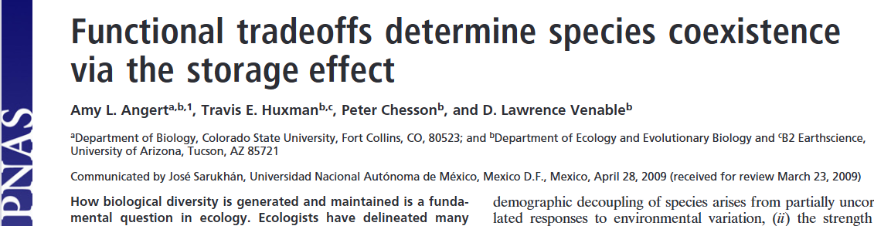
Storage Effect

Slide 52
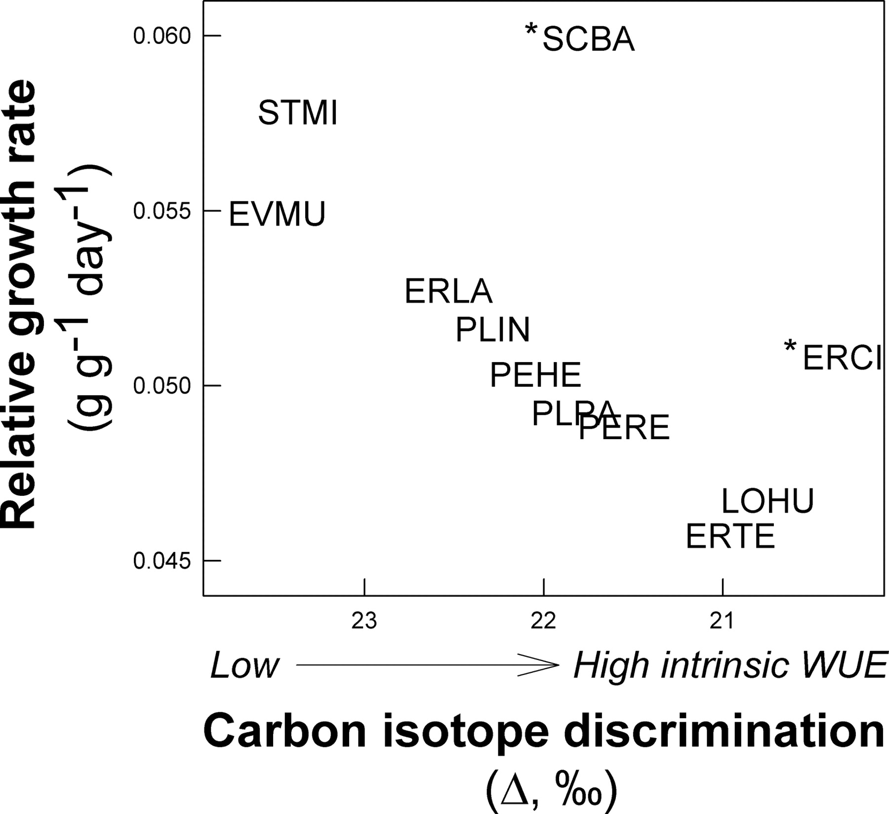
Storage Effect

Slide 53
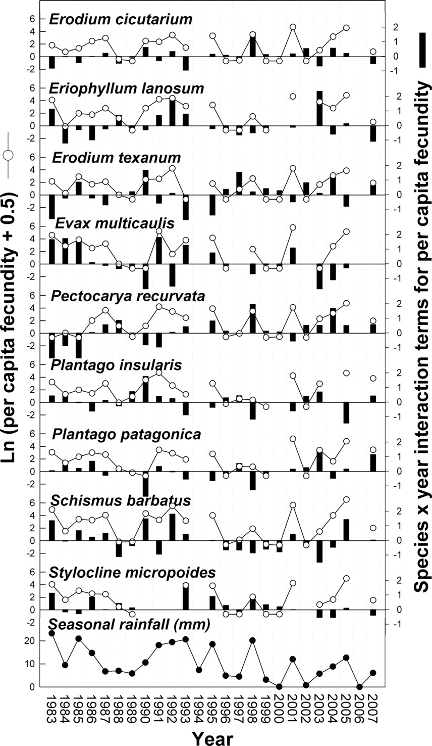
Storage Effect

Slide 54
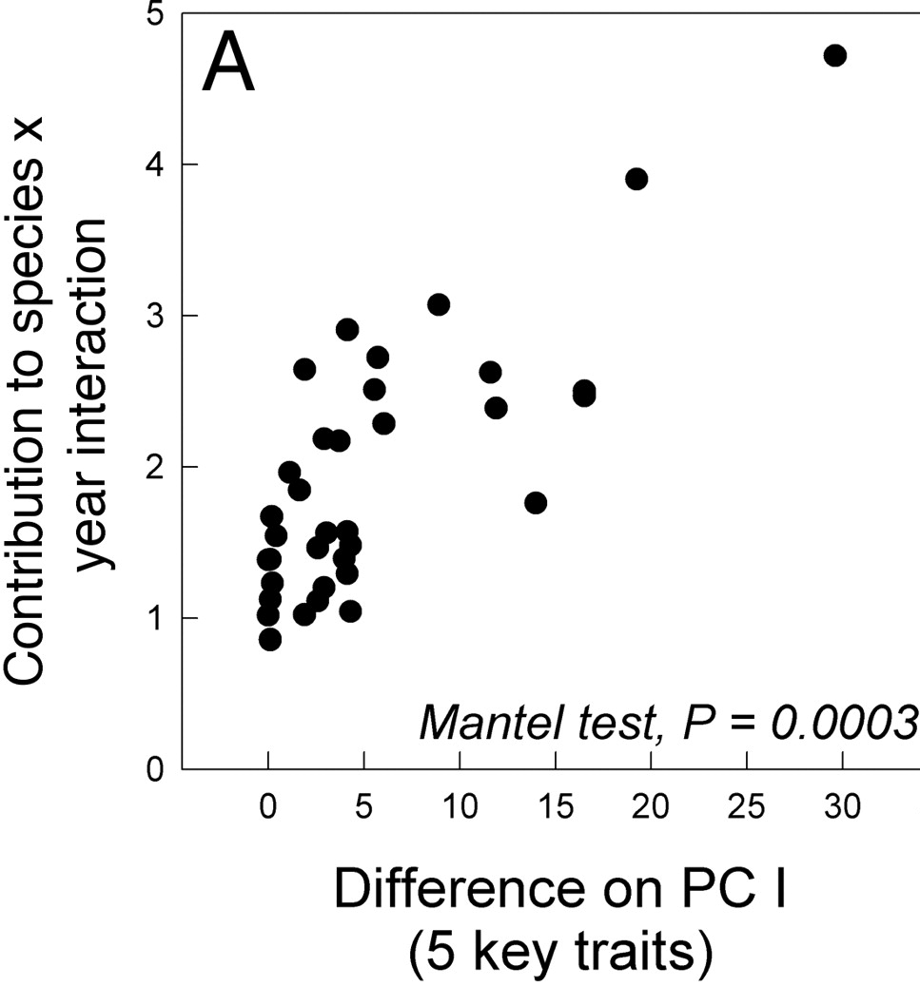
Storage Effect

Slide 55
Main Takeaways
Species coexistence requires meaningful differences
Species can differ in resource/predation in space and/or time
Trade-offs are critical!
Trade-offs need to make α_{ii} > α_{ji} for coexistence

Slide 56
Next class: Mutualism and Facilitation

